Slide 1
Introductory General Chemistry
Chemistry 3A
S. M. Halloran

Slide 2
Word Equations
Chemical Equations
Balancing Equations
Predicting Reactions: Single & Double Displacement Reactions
Writing Chemical Equations for Reactions in Solution
Complete Chemical Equations
Complete Ionic Equations
Net Ionic Equations
Oxidation/Reduction
How to understand them and to apply them

Slide 3
Chemical Reactions & Conservation Laws
Chemical reactions are expressed in a way just as mathematics uses equations: to show something is connected at a time before with something that comes after
A reaction is an expression of substances that react—the reactants—and the result of the reaction—the products
Reactants → Products
The expression of these is about the conservation laws of mass (matter), energy, and electric charge

Slide 4
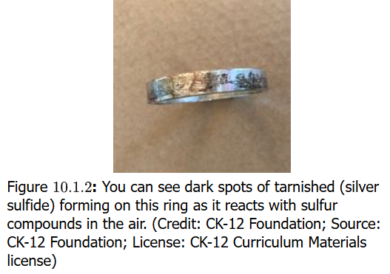
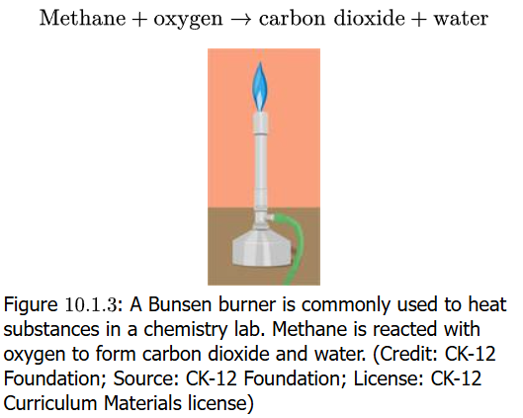
Equations in Words
Chemical reactions are expressed essentially as equations, and the expression can be in words
Silver metal solid is reacted with sulfur with the result it forms silver sulfide
If you have ever seen tarnish on silver metal set, you see silver sulfur compound
When natural gas (methane) is burned in a Bunsen burner, the gas reacts with oxygen (O₂) in the air to produce carbon dioxide (CO₂) and water (H₂O)
A problem with equations as words is that they can not indicate the quantitative nature of reactions
See also https://youtu.be/vTq4sgGd2QU

Slide 5
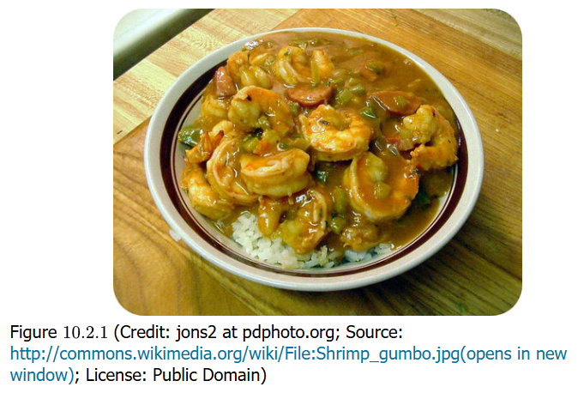
Steps in Chemistry = Recipe
Yum! Yum!
Your book wants to point out that steps in laboratory work such as a chemical synthesis align with a metaphor of making a delicious preparation of shrimp gumbo
Chemists are probably good in the kitchen as well because they must carefully, meticulously gather the ingredients and then “cook” them in the correct way to get an exacting result

Slide 6
Chemical Equations
Chemical equations start with using chemical formula which express matter as the symbols of the elements of the Periodic Table
The reactants and products as compounds are a sketch of the reaction. This is the skeleton equation
CH₄ + O₂ → CO₂ + H₂O
The next step is to indicate the physical state of the compounds:
CH₄ (g) + O₂ (g) → CO₂ (g) + H₂O (l)
(s) = solid, (l) = liquid, (g) = gas, (aq) = compound in aqueous phase

Slide 7
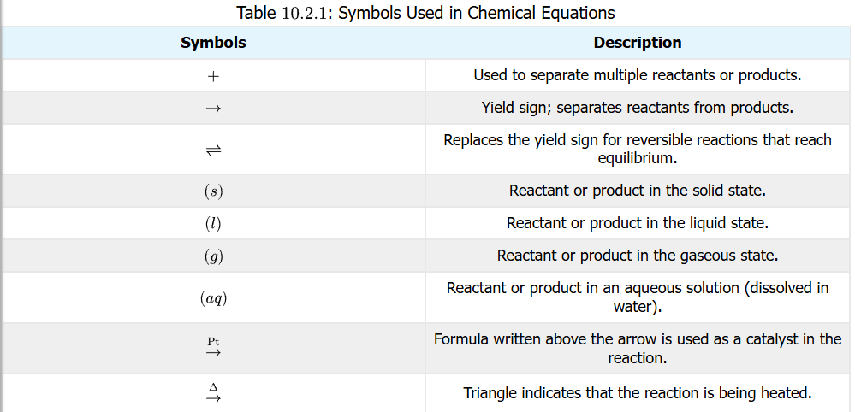
Symbols in Chemical Equations
It is important to understand the symbols used in chemical reaction equations
See also https://youtu.be/ZcF8E8aAOGs

Slide 8
Balancing Equations
With the skeleton equation up on the whiteboard, it is time to apply the laws of the conservation of mass (electric charge & energy can be examined later)
One of the most important beginnings in chemistry is writing reactions (equations) that show the formation of compounds from their elemental forms
practice exercises calculating the enthalpy of formation is often seen with this
The elemental form of carbon is C (s). The elemental form of hydrogen is H₂ (g)
From these two, the formation of methane CH₄ (g) is shown
C (s) + H₂ (g) → CH₄ (g)
The equation is missing mass balance however, which it must have on both sides of the reaction arrow
There is one atom of C on both sides, so that’s OK, but there are 2 atoms of H on left side, but 4 atoms on the right. The left needs 2 more atoms, which can be done by doing the following:
C (s) + 2 H₂ (g) → CH₄ (g)

Slide 9
Details of Balancing Equations
In the previous slide, a 2 was added to the H₂ (g) reactant to achieve the balance of atoms on both sides of the reaction arrow
C (s) + 2 H₂ (g) → CH₄ (g)
This 2 and any whole number/integer placed in front of a chemical compound in a chemical equation is called a coefficient
This is also term in mathematics for a number placed in front of a variable in an algebraic expression
Putting a coefficient in front of a compound has the effect of multiplying the number of each atom in the compound by the number of the coefficient, and if the atom is subscripted, by that subscript number too
2 H₂ = 2 x 2 H = 4 H atoms 2 CO₂ = 2 x 1 C = 2 C atoms; 2 x 2 O = 4 O atoms 4 H₂O = 4 x 2 H = 8 H atoms; 4 x 1 O = 4 O atoms 3 MnO₄ = 3 x 1 Mn = 3 Mn atoms; 3 x 4 O = 12 O atoms

Slide 10
Steps To Balancing Equations
Set up the skeleton equation: write down the correct chemical formulas on each side of the reaction arrow, the reactants and products
Identify all atoms and count the number of atoms on the reactant and product side
If polyatomic ions are unchanged on both sides, count it as a unit
Begin the balancing by focusing on elements that occur in only one compound on one side
For instance, oxygen often in appears in more than one compound on one side the arrow: do not start with balancing oxygen atoms
Balancing can ONLY be done by using coefficients: changing subscripts changes the chemical nature of a compound, and this is not permitted
When satisfied of completion, verify the numbers of atoms on both sides of reaction arrow
Make sure coefficients have lowest possible ratio, while remaining integers

Slide 11
Practice Balancing Equations
Set up the skeleton equation: write down the correct chemical formulas on each side of the reaction arrow, the reactants and products
Identify all atoms and count the number of atoms on the reactant and product side
If polyatomic ions are unchanged on both sides, count it as a unit
Begin the balancing by focusing on elements that occur in only one compound on one side
For instance, oxygen often in appears in more than one compound on one side the arrow: do not start with balancing oxygen atoms
Balancing can ONLY be done by using coefficients: changing subscripts changes the chemical nature of a compound, and this is not permitted
When satisfied of completion, verify the numbers of atoms on both sides of reaction arrow
Make sure coefficients have lowest possible ratio, while remaining integers

Slide 12
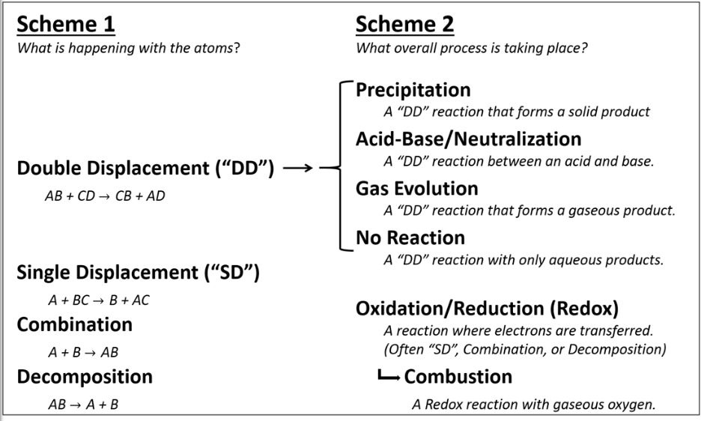
Types of Reactions

Slide 13
Decomposition Reactions

Slide 14
Combustion Reactions

Slide 15
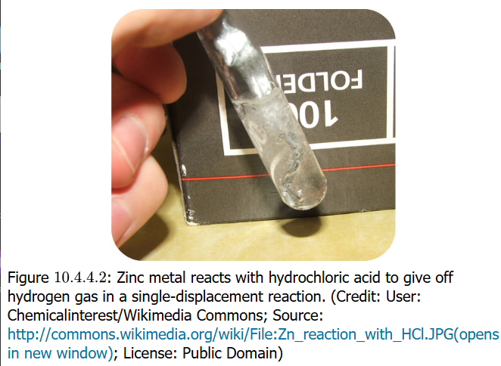
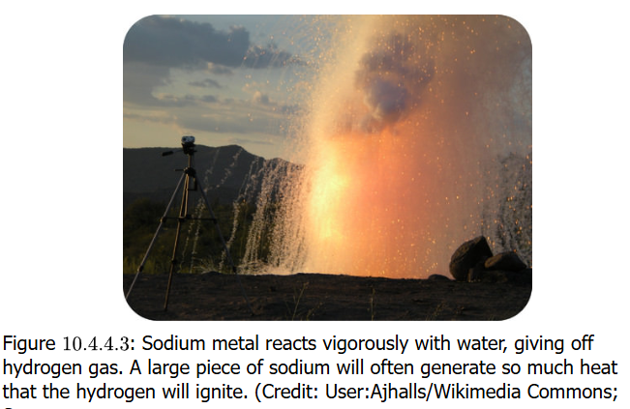
Single Displacement/Replacement Reactions

Slide 16
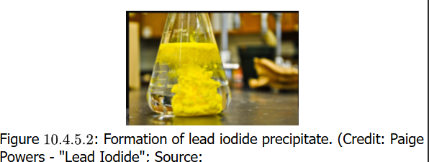
Double Displacement/Replacement Reactions

Slide 17
Predicting Single Displacement Reactions

Slide 18
Predicting Double Displacement Reactions

Slide 19
Precipitation Reactions

Slide 20
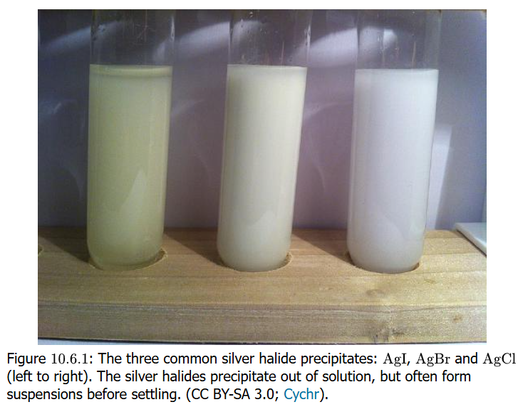

Writing Equations for Reactions

Slide 21
Oxidation States

Slide 22
Oxidation States & Redox Reactions

Slide 23
Half Reactions

Slide 24
Activity Series

